Slide 1

Elevating
A Competitive Analysis and Roadmap for Improvement

Slide 2
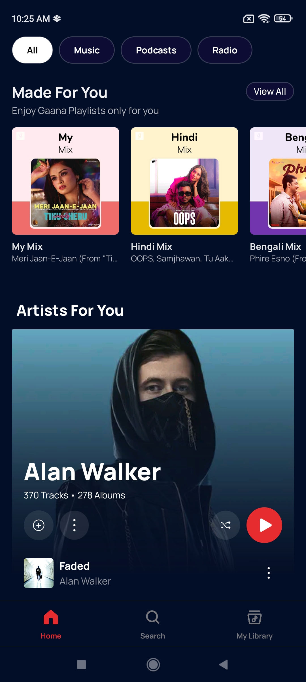

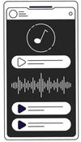
AGENDA
Market overview
Competitive analysis
Subscription plans
1v1 direct comparison
Gaana statistics
SWOT analysis

Slide 3
Market
Overview

Slide 4
Music streaming industry
The Music Streaming market in India is projected to reach a revenue of ₹US$531.90m in 2024.
It is expected to show an annual growth rate (CAGR 2024-2027) of 7.55%, resulting in a projected market volume of ₹US$661.70m by 2027.
In global comparison, in the United States is set to generate the highest revenue in the Music Streaming market, with an estimated ₹US$12,110.00m in 2024.
India's music streaming market is booming, with a surge in local and regional content attracting a diverse and growing audience.
Statista

Slide 5
Competitive analysis

Slide 6






Major players
Spotify
YouTube music
Wynk music
Amazon Music
Jiosaavn
Gaana

Slide 7
Market leaders

Slide 8
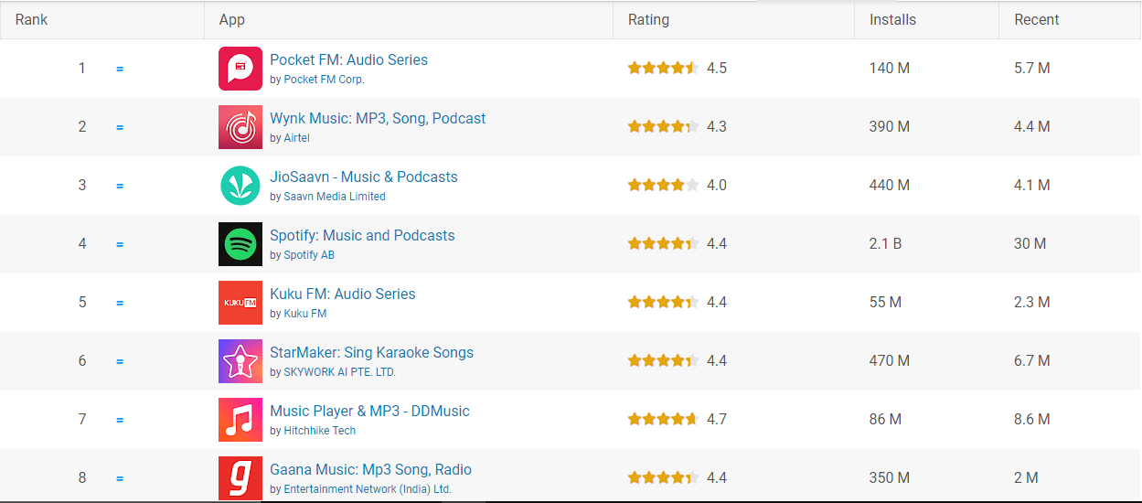

Current market position Google play store ranking: audio and music
Notes:
Recents: Downloads in last 30 days
Installs: Total installs
Keywords in title and description
Downloads; rating and reviews
Content quality; optimization for platforms
Session duration

Slide 9
Subscription plans
Individual: ₹119/month(₹59 for first 3 months)
Duo: ₹149/month(1st free)
Family(6 accounts): ₹179/month(1st month free)
Mini: ₹25/week
Student: ₹59 for 2 months(1st month free)
Individual: ₹99/month(1st month free)
₹990/annum(one time)
Family(5 accounts): ₹149/month(1st month free)
Student: ₹59/month(1st month free)
Individual: ₹49/month
**Offered with some Airtel prepaid/postpaid plans**

Slide 10
Subscription plans
One must be a prime member to avail the benefits of amazon music
It also comes bundled with some broadband plans
Individual pro: ₹89/month(1st month free)
₹749/annum(one time)
Pro duo: ₹89/month(1st month free)
₹1299/annum(one time)
Pro family(6 accounts): ₹149/month(1st month free)
₹1299/annum(one time)
Student: ₹49/month(1st month free)
₹399/annum
Individual lite: ₹5/day, ₹19/week
Individual: ₹1/month (trial)
Monthly: ₹99/month
*Annual(offer): ₹299/annum*
Annual : ₹599/annum

Slide 11
Two-Feature Competitive Landscape Chart
Personalization/recommendation
Subscription plans & pricing

Slide 12
A Side-By-Side Comparison
Gaana vs Spotify
Gaana |  | Spotify
Free streaming
No Brand positioning: appealing to users who are willing to pay for a superior music streaming experience Focus on quality over quantity Consistent Revenue Stream Reduced Operational Costs |  | Yes Freemium model: Ad revenue Lowers the barrier to entry Conversion to paid users Data collection: Algorithm training Artist exposure
Catalog size
Smaller catalog Primarily focusing on Indian music across various languages and genres. It includes Bollywood, regional music, devotional songs, and podcasts. |  | Larger catalog Has a larger global catalog with over 100 million tracks, including a diverse range of international artists and genres. Spotify also offers a wide variety of podcasts and exclusive content.
Collaborative playlist
No Gaana should be offering a similar feature to increase user engagement and retention |  | Yes Helps with users with social interaction Benefits Spotify with increased user engagement, retention and data collection.
Music identification
Yes Gaana allows user to identify music that is being played in the surroundings |  | No Spotify has no such music identification feature

Slide 13
A Side-By-Side Comparison
Gaana vs Jiosaavn
Gaana |  | Jiosaavn
Free streaming
No Brand positioning: appealing to users who are willing to pay for a superior music streaming experience Focus on quality over quantity Consistent Revenue Stream Reduced Operational Costs |  | Yes Freemium model: Ad revenue Lowers the barrier to entry Conversion to paid users Data collection: Algorithm training Artist exposure
Premium sound
320kbps Gaana allows premium users to stream in high definition at 320 kbps with Dolby support, which is a high bitrate audio streaming |  | 320kbps(+lossless) Jiosaavn has lossless support with hiRes audio for premium users only.
Caller tune
No Gaana is not a cellular network provider hence having an integrated caller tune service is not possible |  | Yes Jio is a cellular first company and can provide with such a feature
Infinite scroll
No Not a required feature |  | Yes Gimmicky feature

Slide 14

Competition benchmarking
Parameters | Gaana | Jiosaavn | Spotify
Age and gender-based personalization | - | -
Listening history | -
Lyrics
Login-wall |  | -
Party mode |  | - | -

Slide 15
Competition benchmarking
Parameters | Gaana | Jiosaavn | Spotify
Onboarding |  | -
Regional language support for display language
Video integration | -
Song identification |  | - | -
Collaborative (shared) playlist | - | -

Slide 16
Competition benchmarking
Parameters | Gaana | Jiosaavn | Spotify
Dynamic/Synchronized lyrics
Cross-fade | - | -
With trivia
Premium only

Slide 17
Gaana Statistics

Slide 18



mAU and active subscriber base Bifurcation
App | MAU | Active Subscribers | Listening MAU
India
International
India
International
8.69M
1.26M
311K
270K
61K
27K
261K
6.7K
2.9K
104k
17.6K
8.9K
mWeb/desktop | MAU | Active Subscribers | Listening MAU
11.93M
19K
4.9K
4.48M
1.5K
699
Notes:
Recents: Downloads in last 30 days
Installs: Total installs
Keywords in title and description
Downloads; rating and reviews
Content quality; optimization for platforms
Session duration

Slide 19
mAU and active subscriber base Bifurcation
App | MAU | Active Subscribers | Listening MAU
Total | 8.69M | 1.35M | 0.35M
Total | 16.41M | 20.5K | 5.5k
mWeb/desktop | MAU | Active Subscribers | Listening MAU
Grand total | 25.7M | 1.37M | 0.36M
Notes:
Recents: Downloads in last 30 days
Installs: Total installs
Keywords in title and description
Downloads; rating and reviews
Content quality; optimization for platforms
Session duration

Slide 20
Subscribers to install base ratio
App | Install base | Subscribers/install base
Total | 10.8M | 11.7%
Notes:
Recents: Downloads in last 30 days
Installs: Total installs
Keywords in title and description
Downloads; rating and reviews
Content quality; optimization for platforms
Session duration

Slide 21
S.W.O.T. Analysis
Strengths | Weaknesses
Oldest Indian music streaming application Enormous user data User-Friendly Interface Playlist import(coming soon) Localized Content | Lost its track High Competition Recommendation cycle is imprecise Smaller catalog Premium only platform Brand image
Opportunities | Threats
Expansion into New/emerging Markets Partnerships and Collaborations Technology Integration Podcasts and Non-Music Content Original Productions | Intense Competition Regulatory Challenges Content Licensing Costs User Retention Challenges Economic Uncertainty
Notes:
Oldest Indian music streaming application: At a point of time had the highest user-base in India
Enormous user data: Being the market leader at a time, has a large amount of user data to be leveraged, providing a better scope for personalization, more data means more effective recommendation model
User-Friendly Interface: The app is known for its intuitive and easy-to-navigate interface, which enhances the user experience and encourages engagement
Playlist import(coming soon): Will be the only application in the entire market to provide such a feature for its users
Lost its track: Due to numerous competitors Gaana lost its first mover advantage
High Competition: The music streaming market in India is highly competitive, with major players like Jiosaavn, Spotify, and Apple Music. This intense competition has impacted Gaana's market share and growth.
Recommendation cycle is imprecise: Needs to leverage user data to improve its recommendation engine
Smaller catalog: Catalog is smaller than the competitors
Premium only platform: It has a hard paywall for music streaming
Brand image: Due to being a freemium model for a long period of time, much awareness is not there that Gaana has now transitioned to a premium platform
Lost its track: Due to numerous competitors Gaana lost its first mover advantage
High Competition: The music streaming market in India is highly competitive, with major players like Jiosaavn, Spotify, and Apple Music. This intense competition has impacted Gaana's market share and growth.
Recommendation cycle is imprecise: Needs to leverage user data to improve its recommendation engine
Smaller catalog: Catalog is smaller than the competitors
Premium only platform: It has a hard paywall for music streaming
Brand image: Due to being a freemium model for a long period of time, much awareness is not there that Gaana has now transitioned to a premium platform
Intense Competition: The presence of well-funded global competitors like Spotify, Apple Music, and Amazon Music poses a significant threat to Gaana's market position.
Regulatory Challenges: Changes in government regulations, particularly related to digital content, copyright, and data privacy, could impact Gaana's operations and profitability.
Content Licensing Costs: The rising cost of content licensing could affect Gaana's profitability, especially if it needs to secure exclusive rights to compete with other platforms.
User Retention Challenges: As users are presented with multiple streaming options, retaining them could become increasingly challenging, particularly if competitors offer better features, content, or pricing.
Economic Uncertainty: Economic downturns or changes in consumer spending patterns could affect Gaana's ad revenues and subscription growth, especially in price-sensitive markets like India.

Slide 22
Suggestions

Slide 23
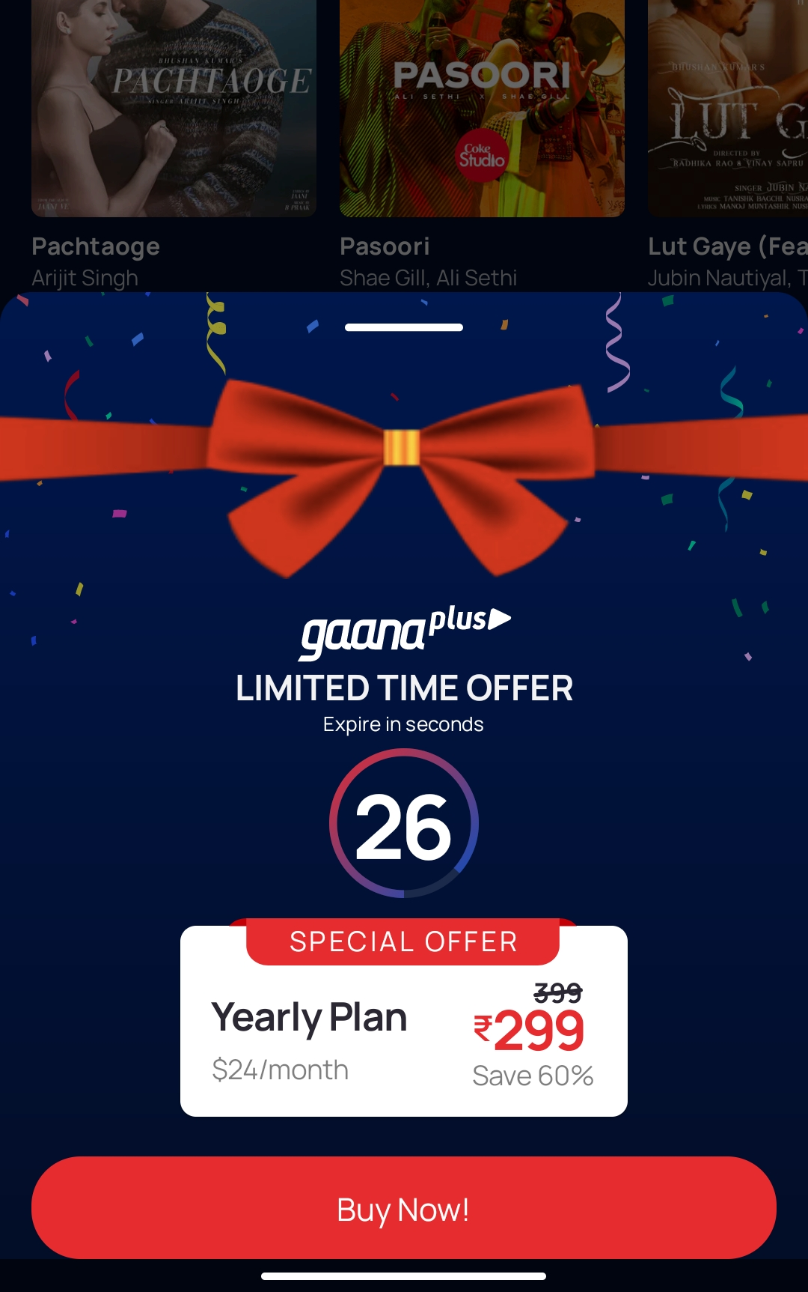
Paid subscribers are shown Gaana+ ads
The most frustrating experience for a paid user is being shown Gaana+ ads

Slide 24
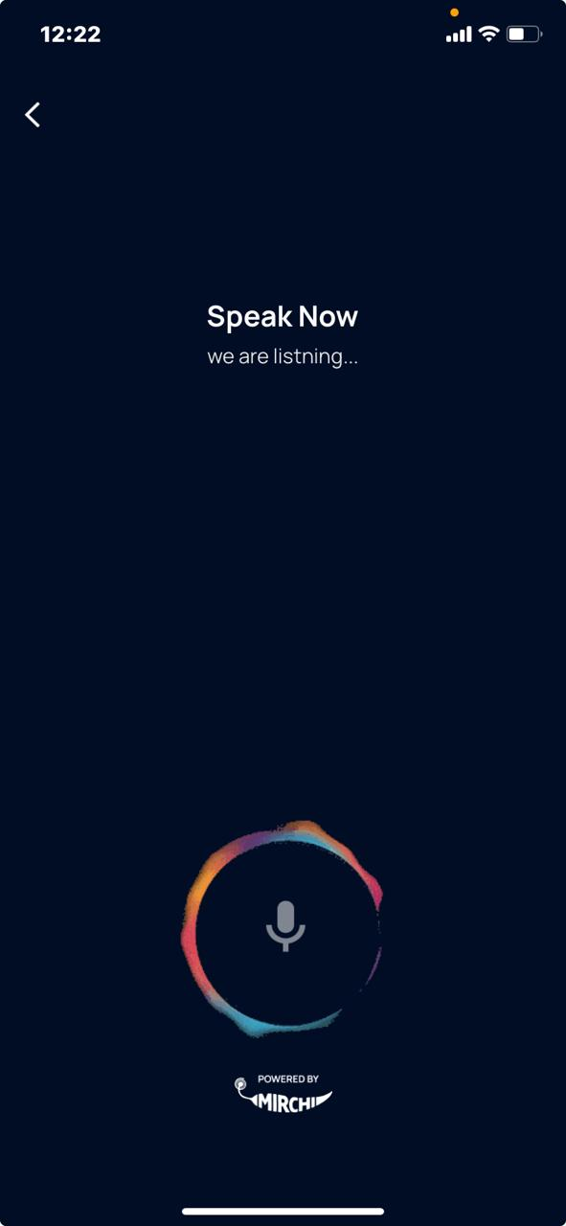
Voice search cannot differentiate between command and actual subject to search
For example, play espresso searches just “play espresso” instead of playing “espresso” song

Slide 25
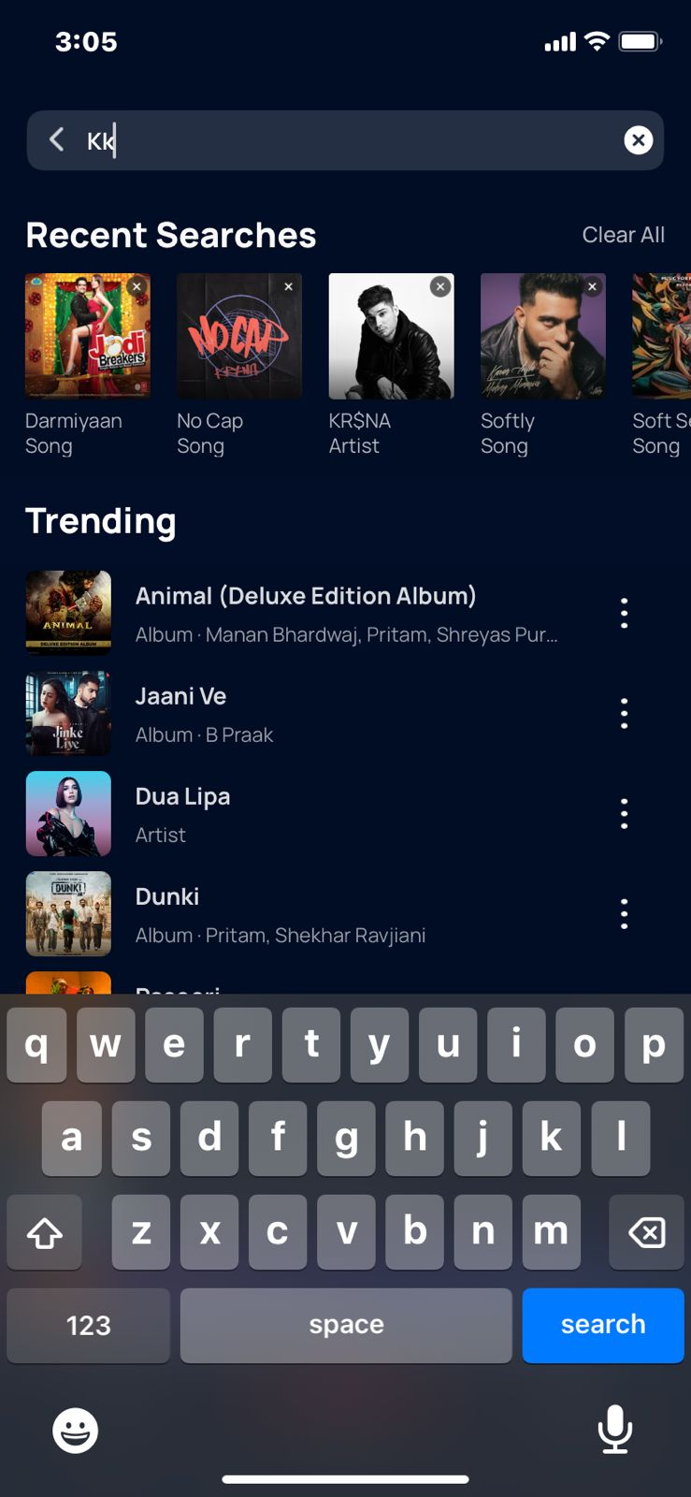
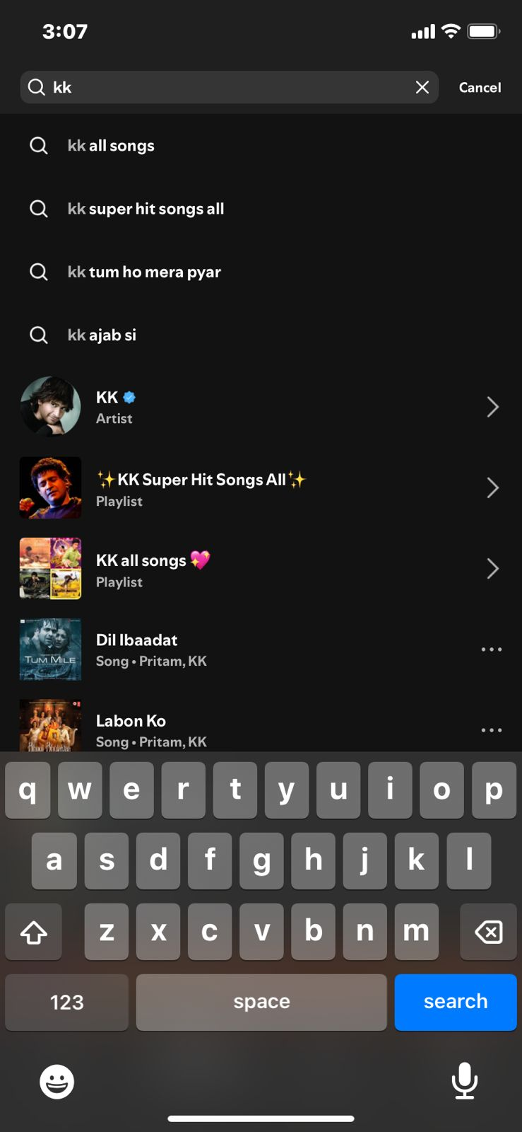
THE SEARCH OVERSIGHT
Gaana’s search is built in such a way that it provides with the results only after 3 letters are input
But if a user wants to search for an artist, album or song which contains only 2 letters then it won’t be able to initiate the search

Slide 26
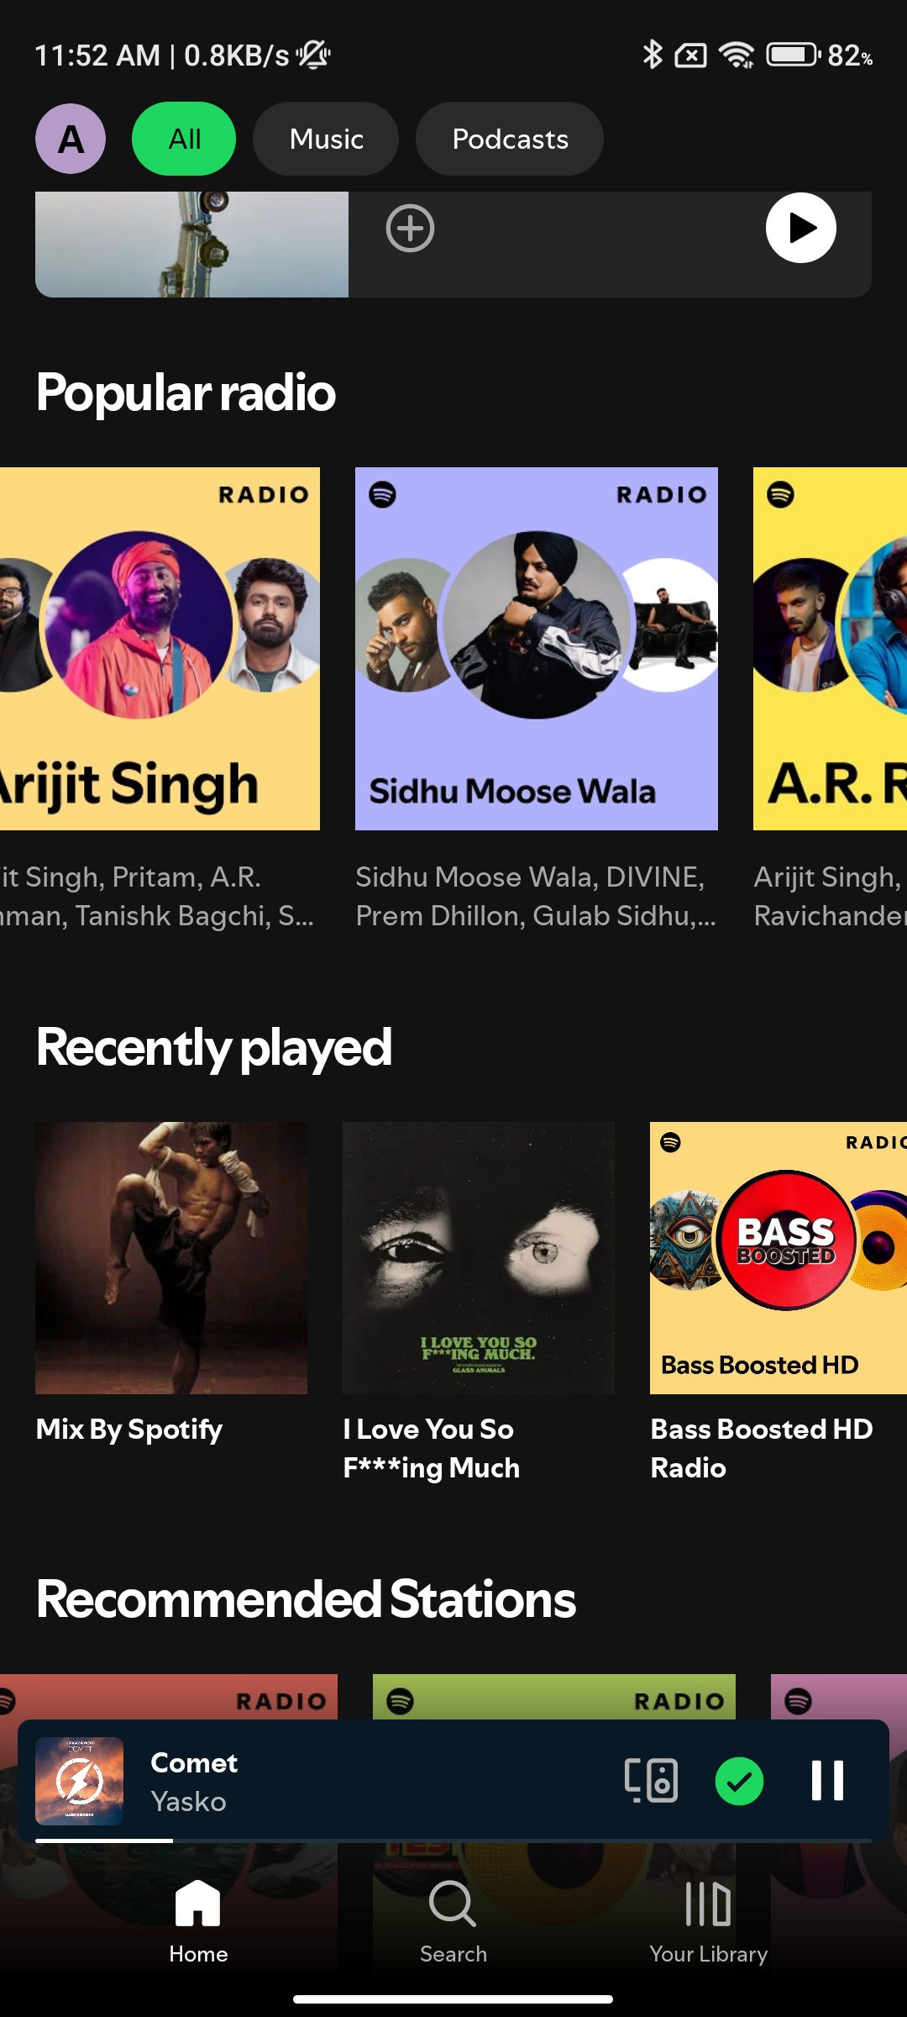
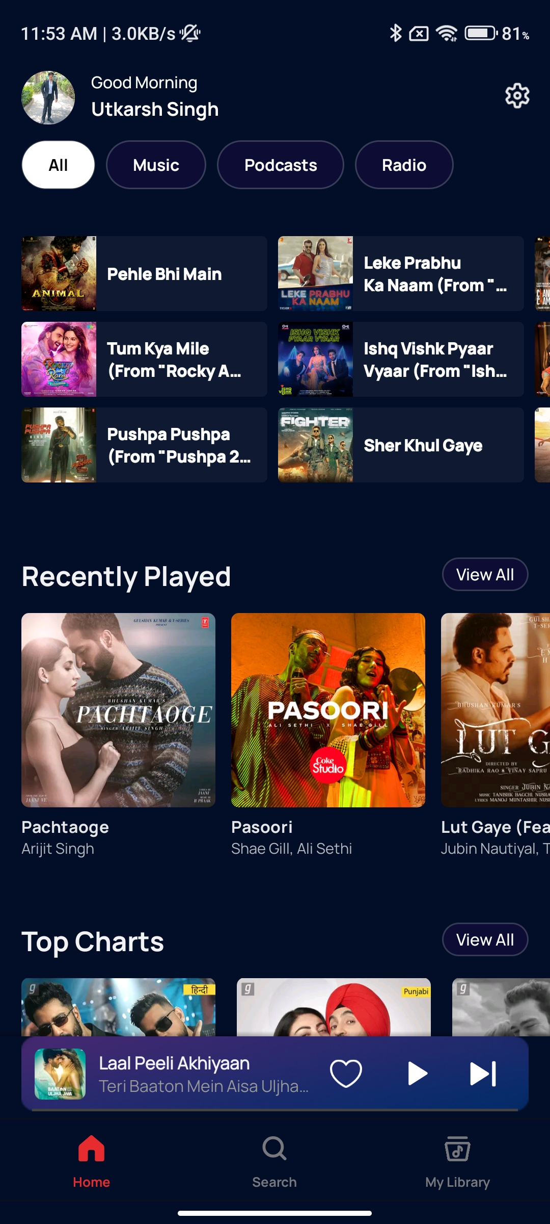
Floating player window should have transparent background
Either integrate the now-playing window with the bottom nav or make it a floating one

Slide 27
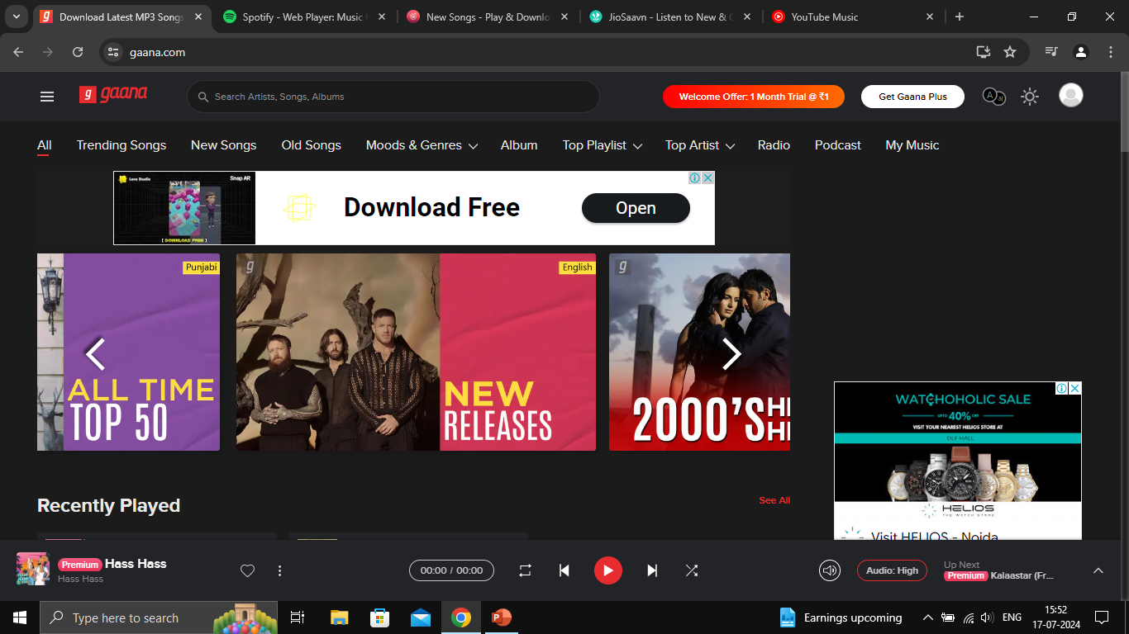
Ad-integration
Gaana should be presented as a premium music streaming platform
It is a subscription-only app
This is how ads are implemented in Gaana, too loud and prominent
Notes:
Ads can be shown in a smarter way instead of conventional way of appearing on the homepage
Since Gaana is a subscription only app it should be presented so
Saavn, YouTube music and Spotify do not have on screen ads even for the non-premium user
This is applicable for both desktop and mobile browsing

Slide 28
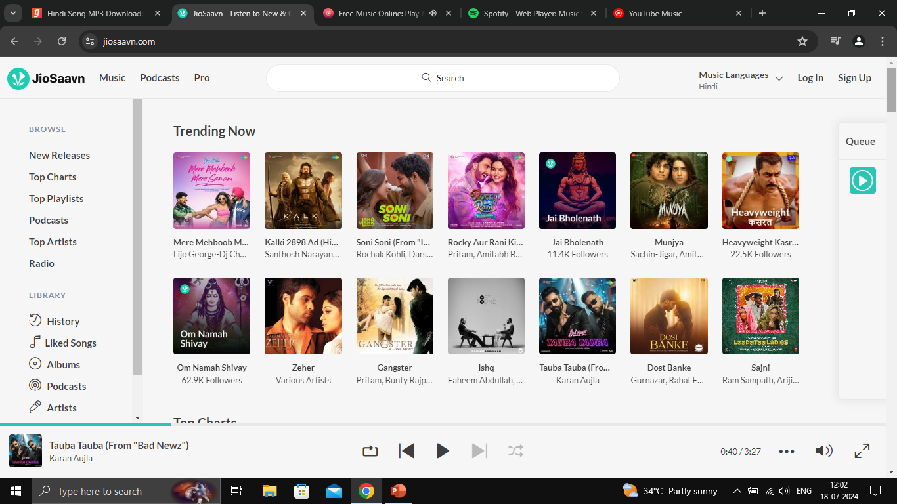
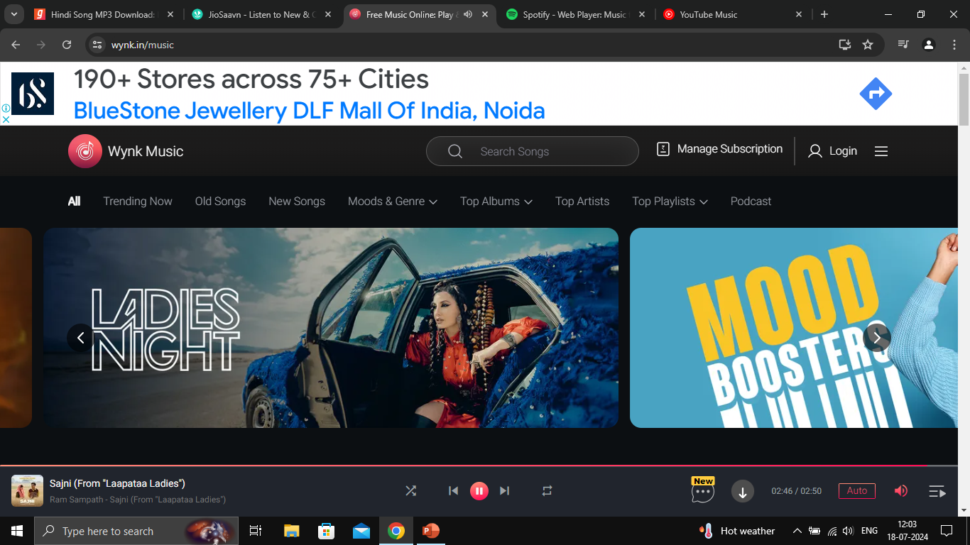
Jiosaavn has a relatively cleaner UI and does not have any on screen ads
(Player ads)
Wynk is the only web-app with on screen ads
(Better integration)
Notes:
Wynk has better execution than gaana when it comes to displaying ads
Either remove ads altogether from the UI
Or integrate ads such that they look a part of UI

Slide 29
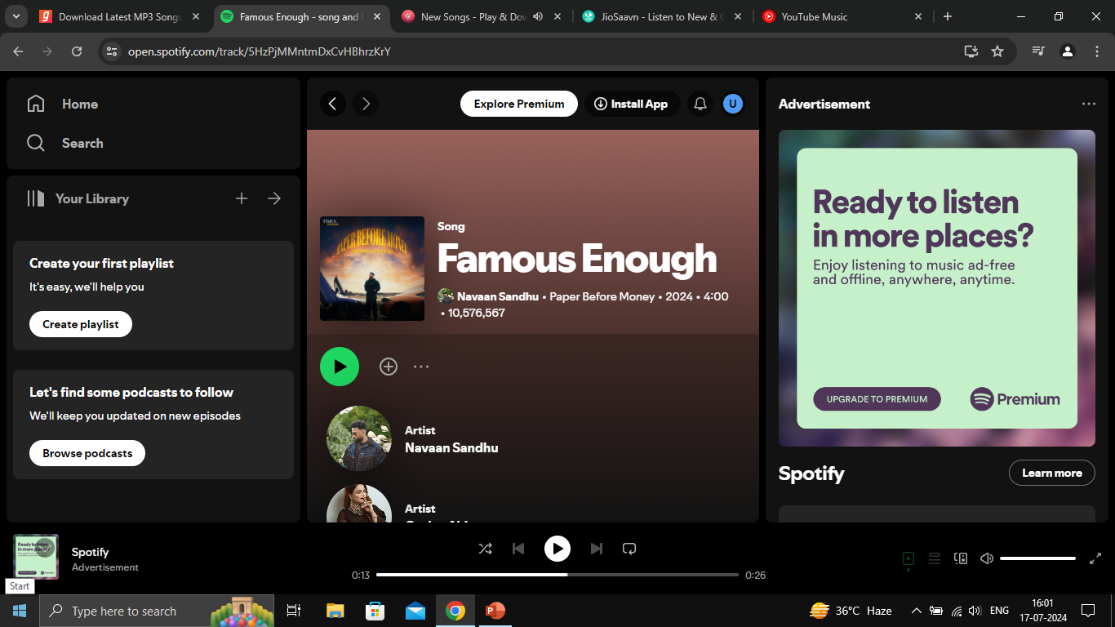
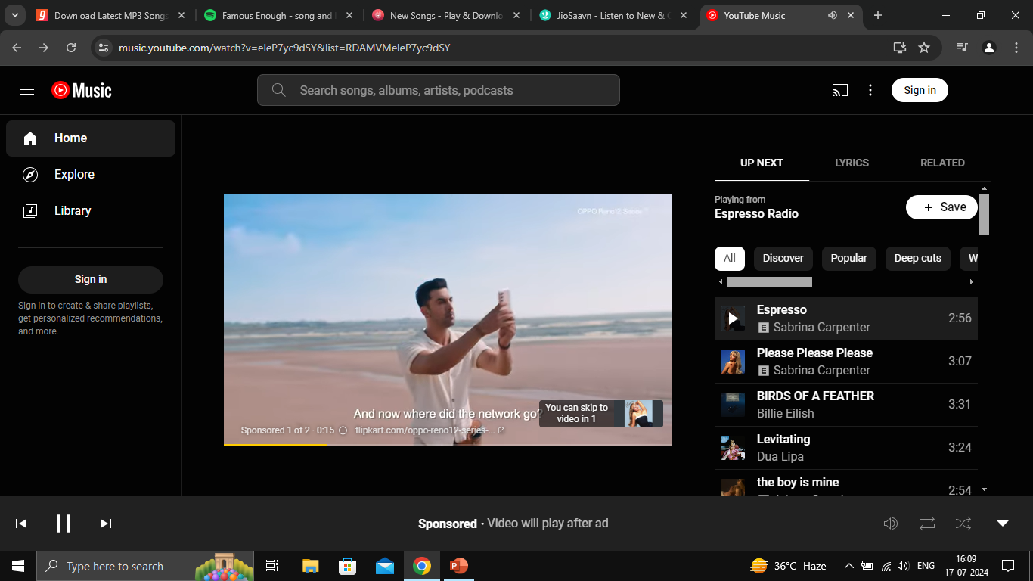
This is how Spotify integrates ads into the music player instead of displaying on screen ads
YouTube music has a different approach towards player and ads but doesn’t display on screen ads
Notes:
This way of displaying ads after a few songs are played is better in terms of usability
On screen ads obstruct the user’s view and adds to the complexity of the homepage
We can utilize this way when a non-subscriber plays podcast

Slide 30
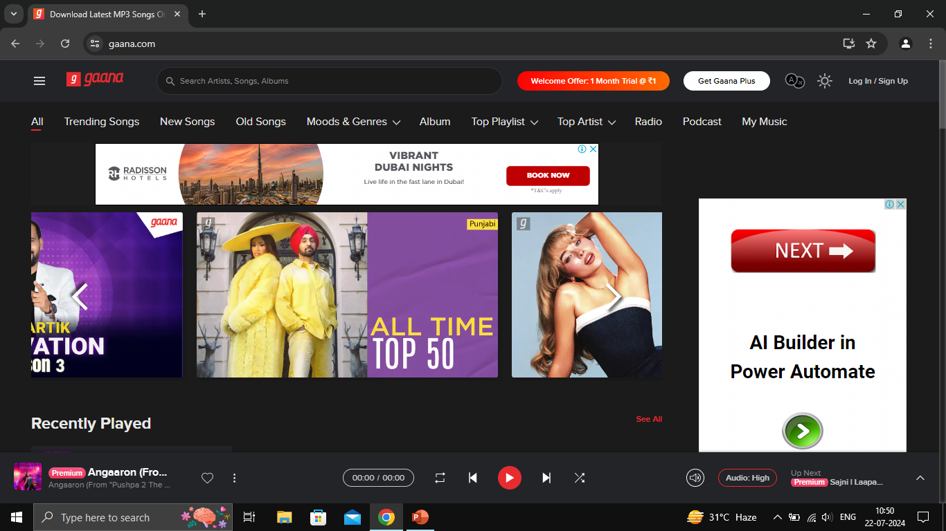
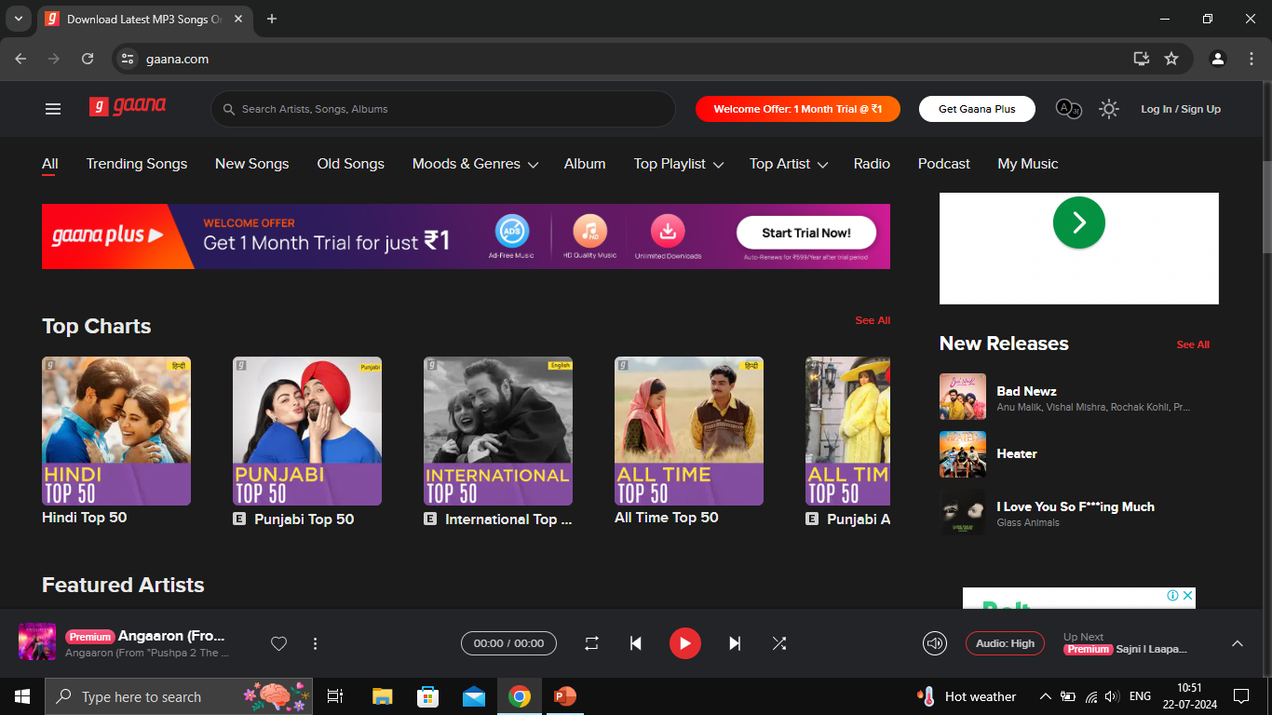
Every alternate slide in the slideshow can be used to display sponsored content
Ads can be displayed like the subscription banner is done
Notes:
Instead of displaying ads how blog websites do, we can display ads in a smarter way such that it doesn’t affect the aesthetics of the page

Slide 31
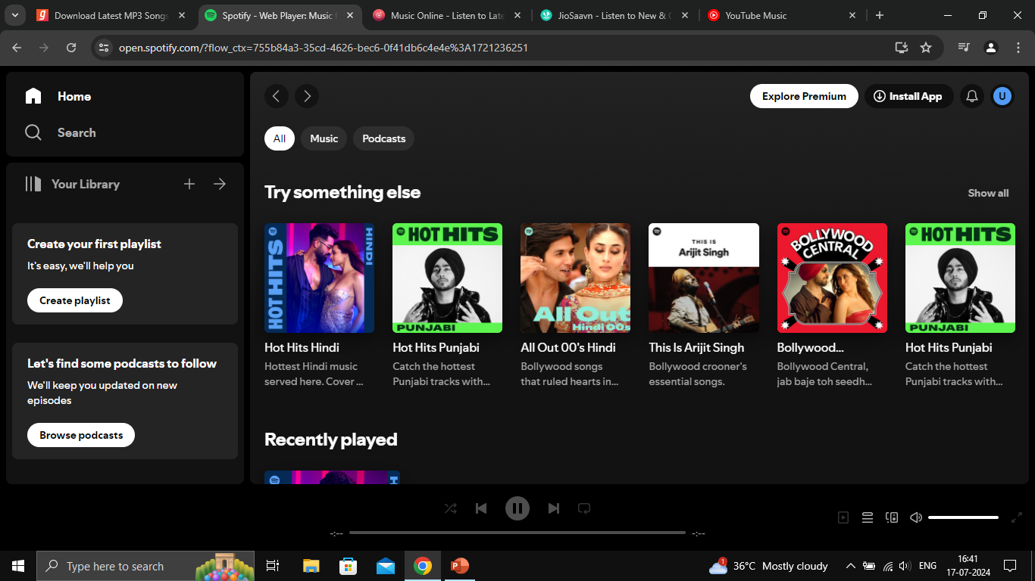
Download- app option for d-web users
This should take the user to google play store where Gaana app can be remotely downloaded
Notes:
To promote app-based usage it is necessary to get web users move to app
Install app hyperlink should be available promptly

Slide 32
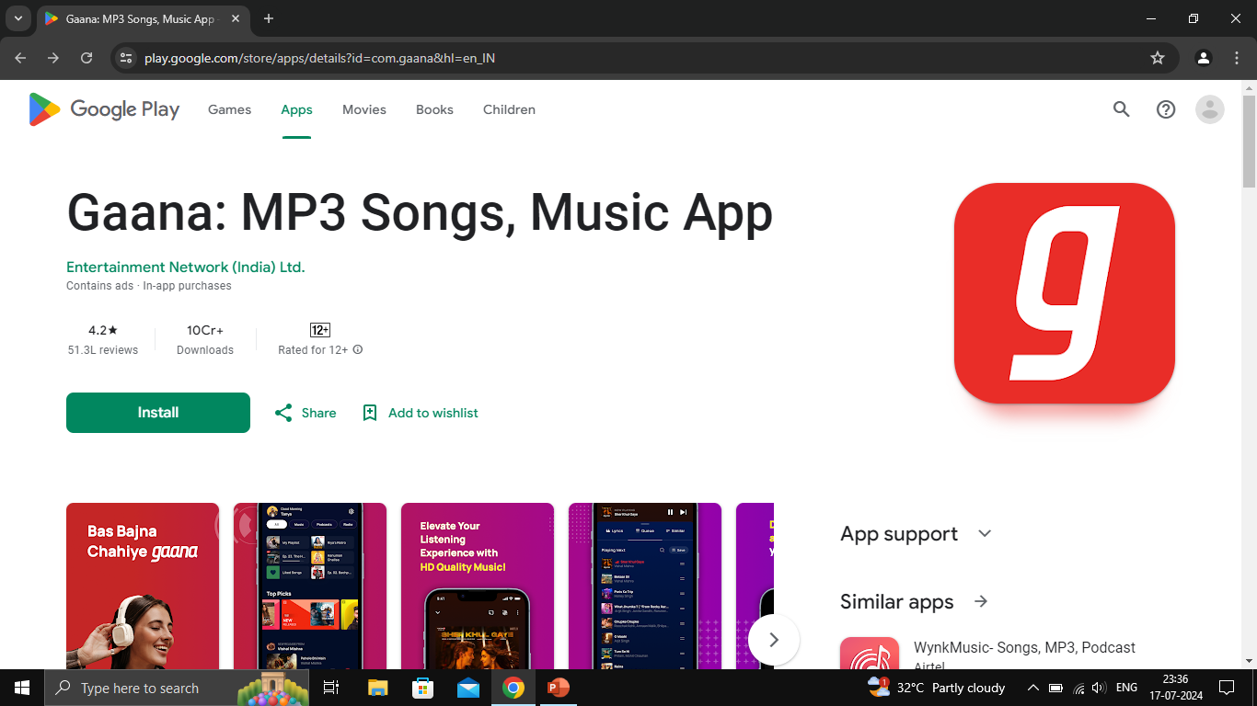
Download on compatible device
TG is majorly android users
We can leverage remote download by play-store

Slide 33
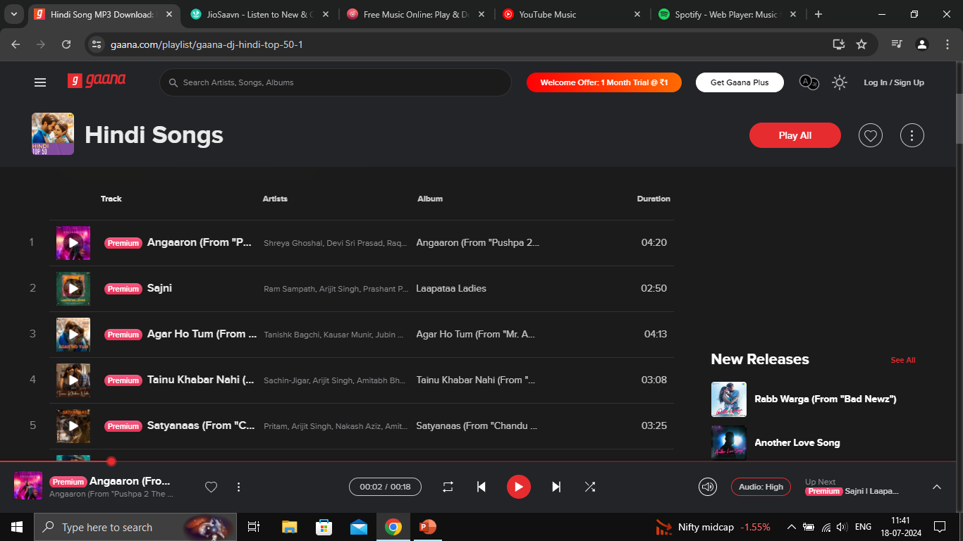
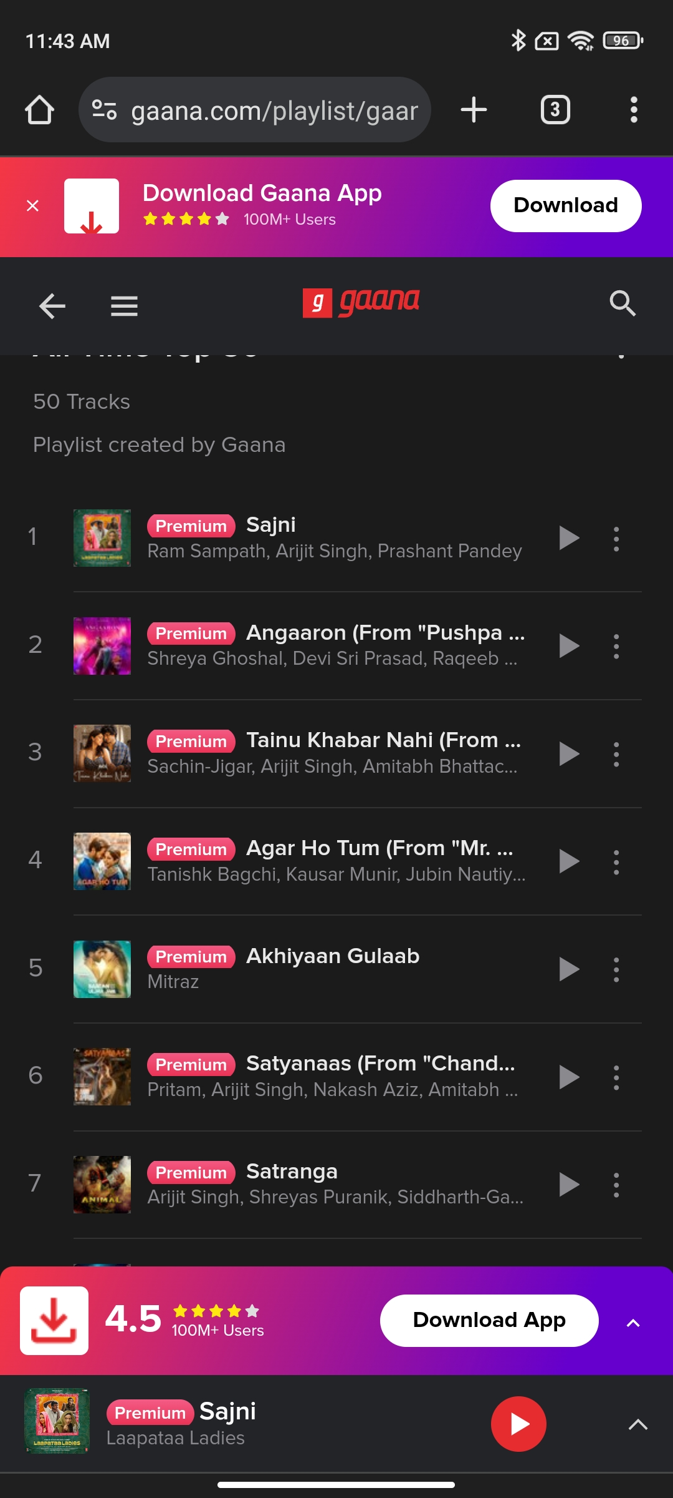
Redundant premium tags

Slide 34
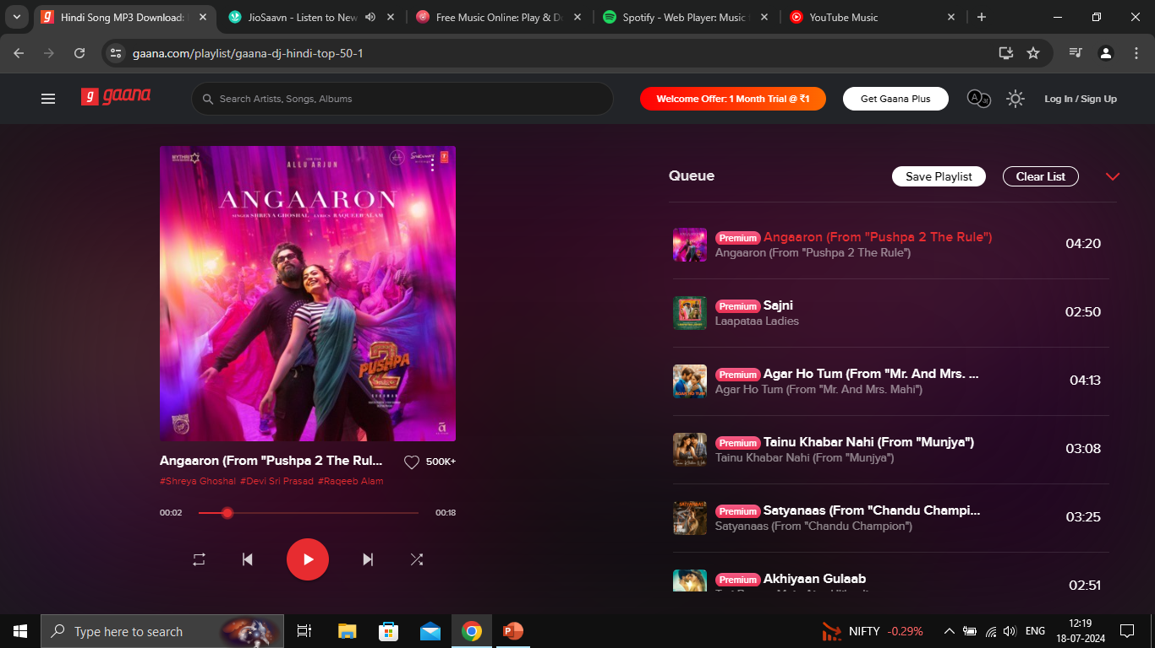
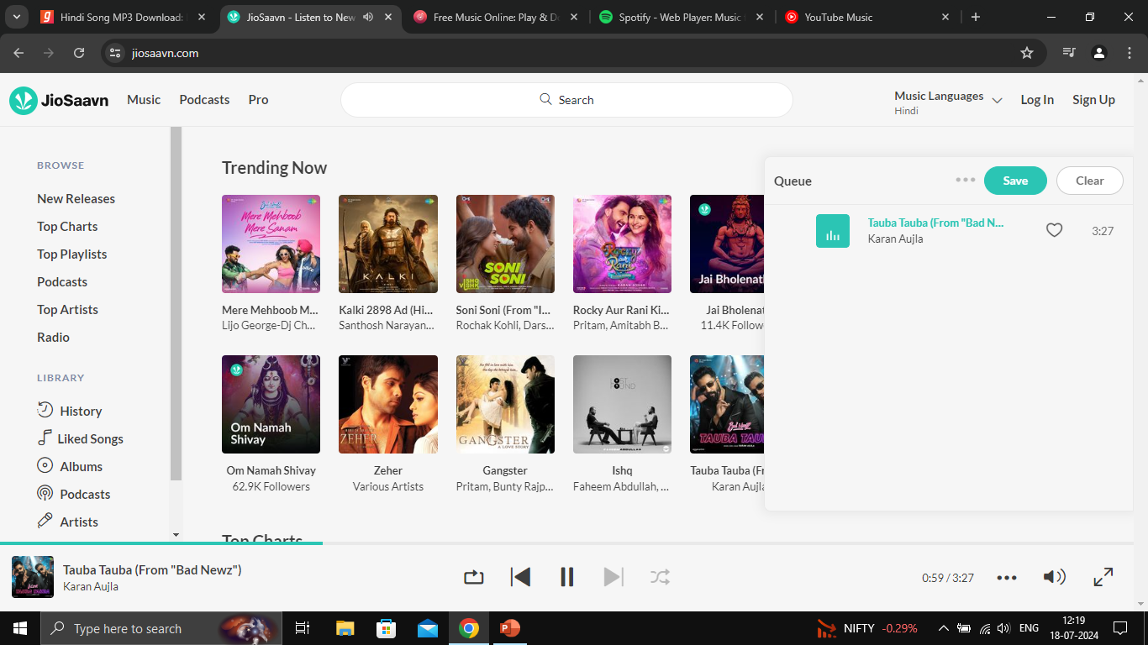
When queue is accessed, user can only modify/use the queue
Queue is a hover and access type; this provides the user with flexibility to simultaneously have access to other features

Slide 35
Add-ons

Slide 36
Application of llm in recommendation

Slide 37
Overcoming nervousness
Input prompt for LLM
Given below are the songs that I have been listening to
Tauba Tauba, karan aujla
Softly, karan aujla
MVP, shubh
King shit, shubh
Hass Hass, diljit Dosanjh
suggest me 10 songs based on my listening history

Slide 38
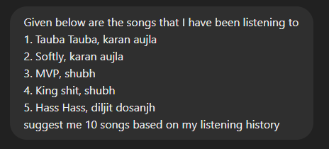
Input prompt

Slide 39
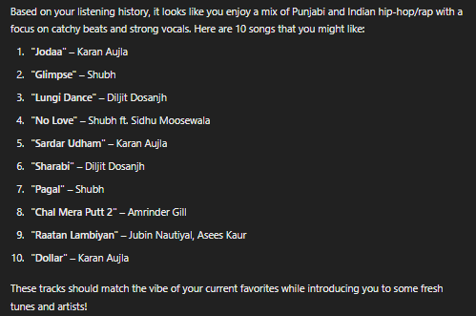
Output prompt

Slide 40
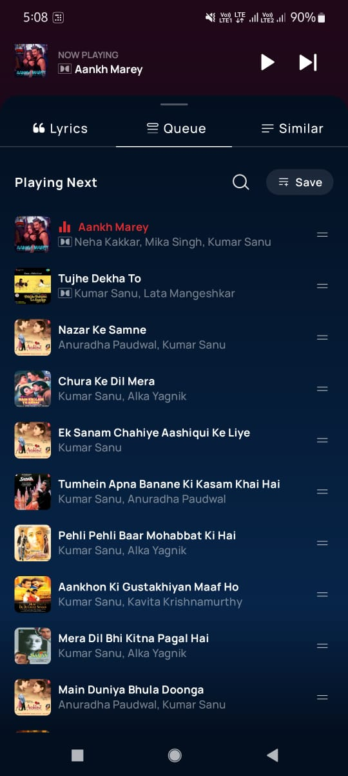
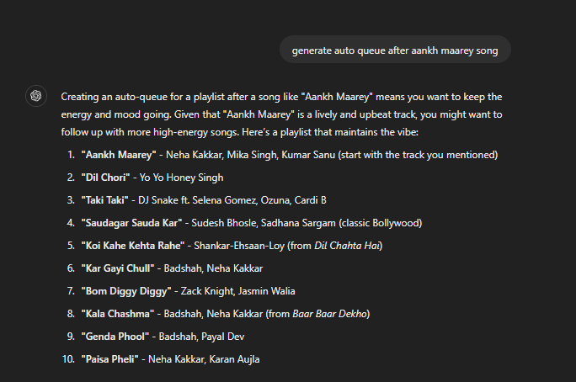
Auto-queue

Slide 41
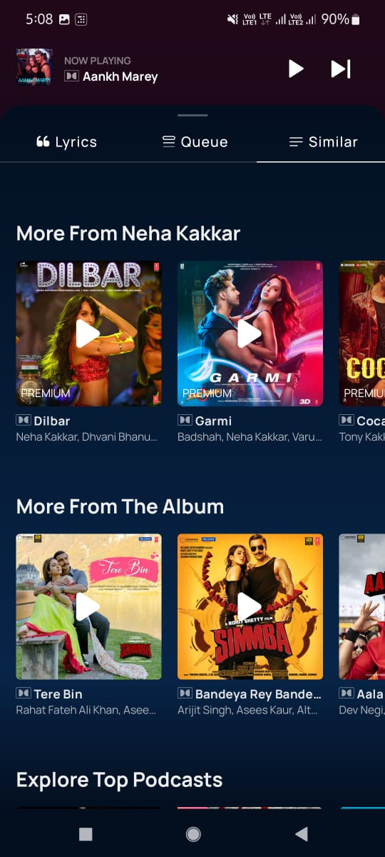
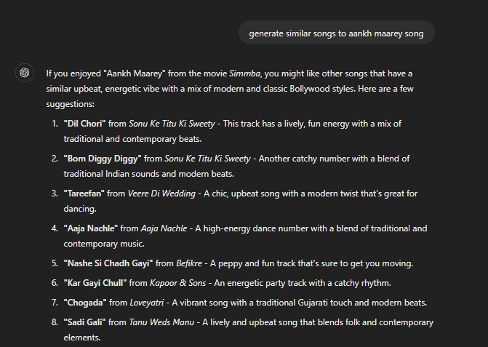
Similar songs

Slide 42
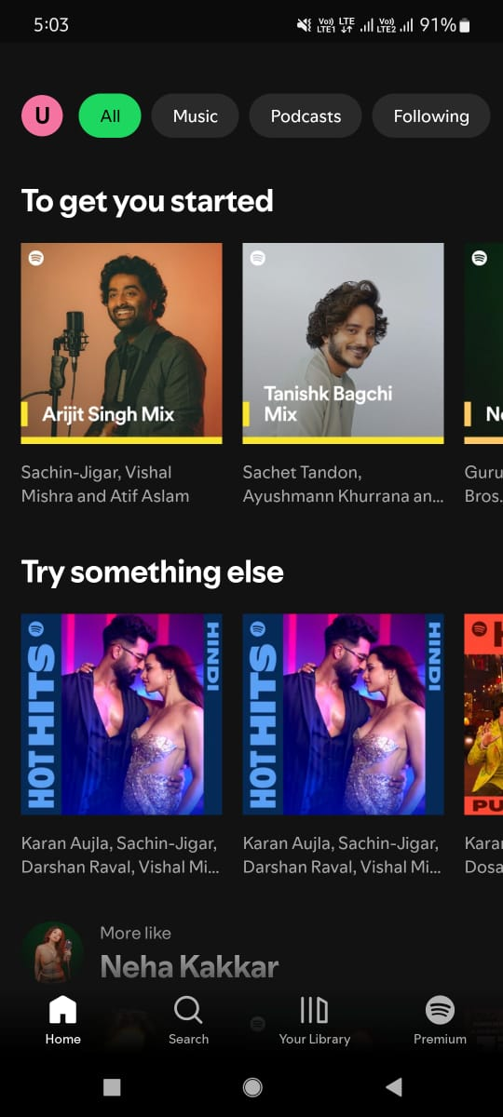
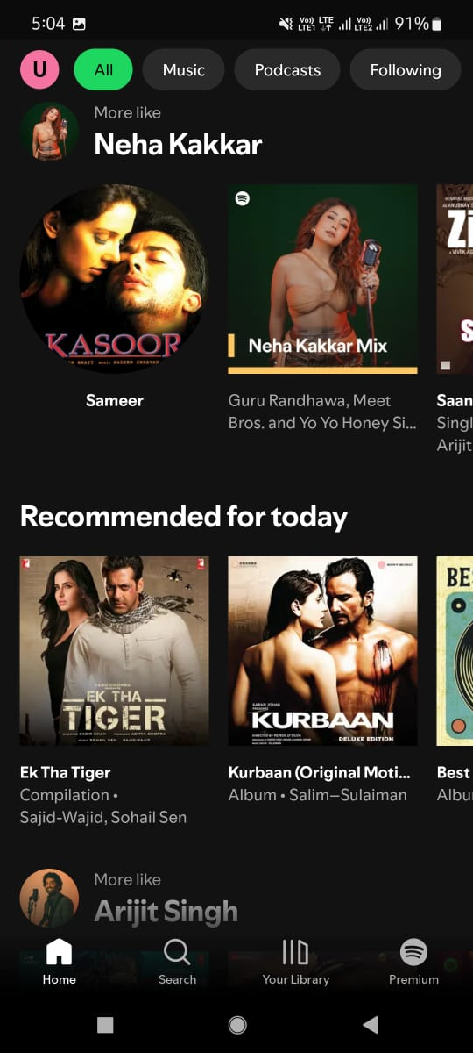
Spotify
Cold start approach:
Based on what artists (3 min) users chose during onboarding
What is trending
More like section

Slide 43
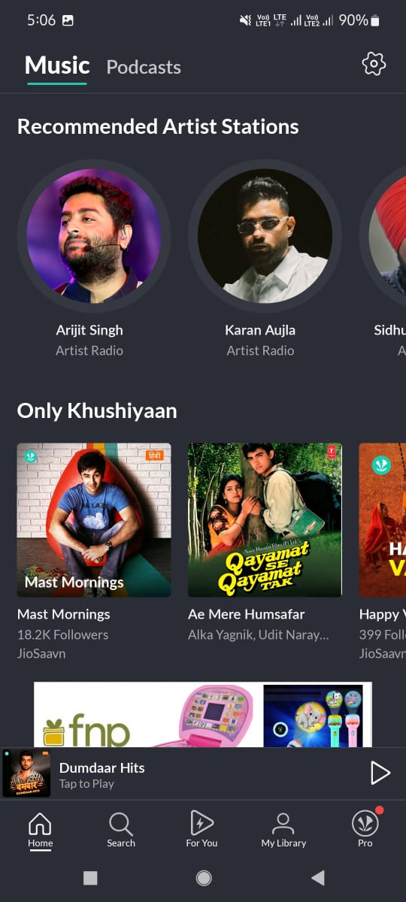
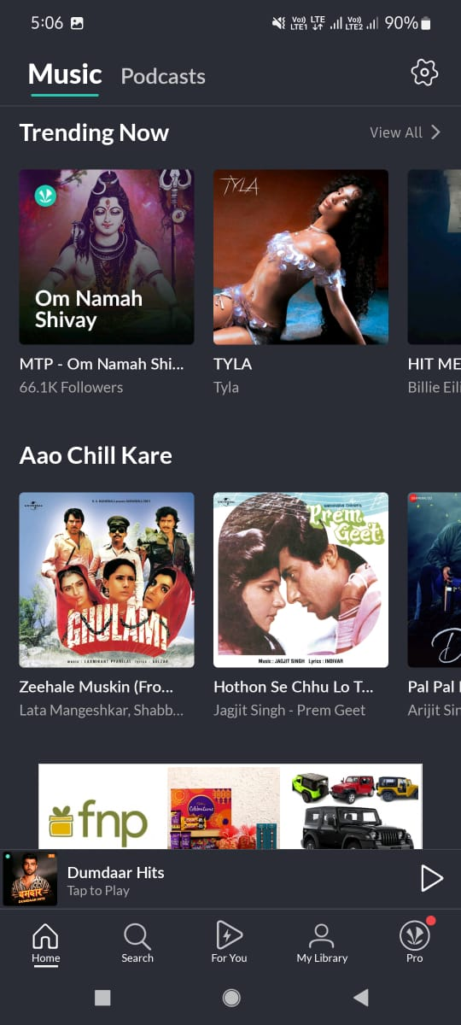
Jiosaavn

Slide 44
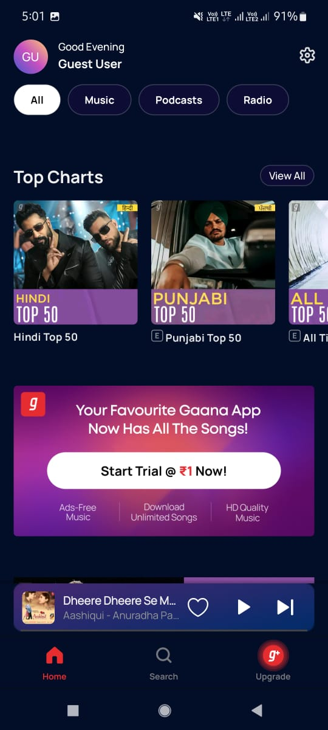
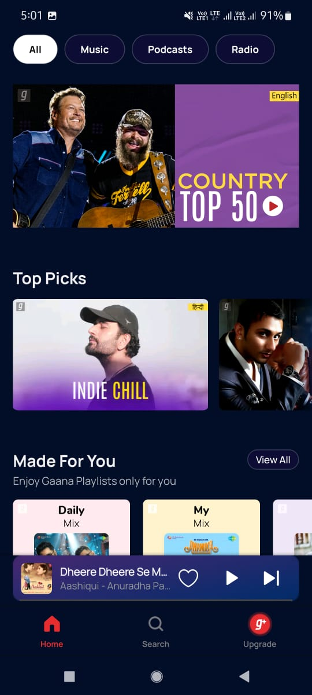
Gaana

Slide 45
THANK YOU
Utkarsh Singh

